Slide 1

COVERLESS INFORMATION HIDING METHOD BASED ON WEB TEXT
TEAM :
K.SADHIKA -216Y1A6724
S.SRINIDHI – 216Y1A6751
T.SHIVANI – 226Y5A6702
V.PRAMITHA – 216Y1A6760
CSD : BATCH 05
MENTOR : SARIKA MAM
[asst . professor]

Slide 2
ABSTRACT
  The coverless information hiding method conceals secret information (SI) within web text without altering the text itself.
  It begins by using a web spider to collect a large volume of relevant text from the internet, creating a library.
  The method then searches this library to find the most suitable text for hiding the information and marks the exact location of the SI using a two-dimensional coordinate system.
  Finally, it combines the URL of the selected text with the location details and sends this information to the recipient.
  Experimental results show that this method improves hiding capacity, success rate, and overall security, making it effective when traditional methods may fail or be easily detected.

Slide 3
INTRODUCTION
Text information hiding conceals data within digital carriers like text, images, videos, and audio. Among these, text-based hiding is common and includes format-based, image-based, and natural language-based methods.
Coverless text hiding retrieves unmodified text from large databases, improving security against detection.
Techniques like Word Rank Map and hash algorithms enhance the process, balancing hiding capacity and security while addressing limitations such as storage and exposure risks.
Current text information hiding methods either modify the carrier, making them vulnerable to attacks, or generate natural language texts that suffer from incoherence, poor readability, and statistical deviations.
The primary objective of this project is to develop a novel, coverless text information hiding technique that utilizes shared big data to embed secret information seamlessly without modifying the original carrier texts

Slide 4
LITERATURE SURVEY
1.Lin Xiang et al. : Proposed a robust text coverless information hiding method based on multi-Index. This approach segments secret information into keywords, transforms them into keyword ids and searches for texts containing these ids in big data text. Features include strong robustness and concealment.
Method : Multi-index approach with random increment factor
Features : Strong robustness, concealment, and security
Limitations : Complexity in managing large-scale text data
2.Pedapati Anitha et al. : Discussed coverless information hiding methods based on image Annotation. This approach focuses on extracting valuable data from large information supplies and Leveraging for information hiding.
Method : Image annotation
Features : Potential for high hiding capacity
Limitations : May require significant computational resources

Slide 5
3.YI CAO ET AL: Proposed coverless information hiding based on anime character generation. This method uses gray gradient co-occurrence to establish a mapping relationship between images and random numbers.
Method: Anime character generation with gray gradient co-occurrence
Features: Potential for high hiding capacity and robustness
Limitations: May be limited to specific types of images or applications.
4.ZHOU ET AL.: Investigated coverless information hiding using image features like color, texture , edge, and contour. This approach establishes precise connections between features and hiding data.
Method: Image feature-based approach
Features: Potential for high hiding capacity and robustness
Limitations: May require significant computational resources and expertise
5.JIAOHUA QIN ET AL. : Discussed coverless information hiding methods, highlighting the importance
of robust image hashing and mapping relationships between features and hiding data.
Method: Robust image hashing and mapping relationships.
Features: Potential for high security and robustness.
Limitations: May require significant expertise in image processing and hashing.

Slide 6
EXISTING SYSTEM
The multi-index approach for coverless information hiding offers strong protection and good concealment of secret information, but it struggles with managing large amounts of text data, making it complicated to use in real-world situations.
Some methods that use image annotation can hide a lot of information, but they often need a lot of computer power, which can be a problem for users with less powerful devices.
Techniques that focus on generating anime characters and using gray gradient patterns can effectively hide information and are robust, but they may only work well with certain types of images, limiting their use in other areas.
Approaches that rely on image features, like color and texture, can create strong connections between the features and the hidden data, but they often require advanced computer skills and significant processing power, which can be a barrier for many users.
Methods that use robust image hashing and mapping relationships provide high security for hiding information, but they demand a lot of expertise in image processing, making them less accessible for people who are not specialists in the field.

Slide 7
PROPOSED SYSTEM WITH FEATURES
The proposed system introduces a novel coverless information hiding method that leverages the vast number of web pages available on the Internet to conceal secret information. A significant advantage of this proposed method is the absence of any modification traces in the web text, ensuring high security and undetectability. It also boasts a high hiding capacity by utilizing the immense volume of web data and maintains a stable hiding success rate.
FEATURES :
No modification of original web texts: This ensures high security and undetectability, as the carrier medium remains unchanged.
Utilizes vast web data: The system takes advantage of the large amount of web data available, which significantly increases its hiding capacity (HC).
Maintains stable hiding rate (SR): The system provides reliable data transmission by maintaining a stable hiding rate.

Slide 8
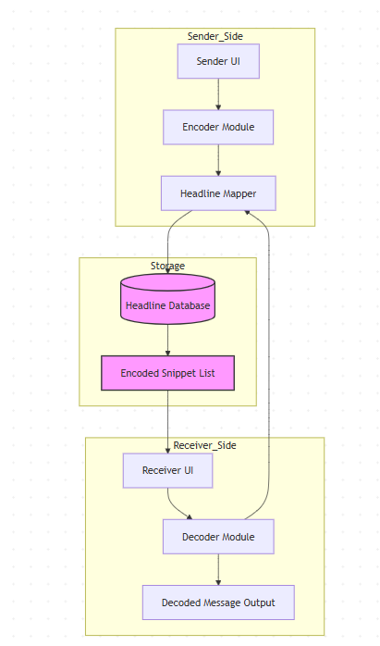
SYSTEM DESIGN
1.Sender _ Side
This section focuses on taking raw input and transforming it into a format suitable for storage and transmission.
2. Storage
This section is dedicated to holding the processed and encoded information.
3. Receiver _ Side
This section handles the reception and display of the processed information.

Slide 9
IMPLEMENTATION
we have designed and implemented a system using Python as the central programming language. Python provides flexibility and a rich ecosystem of libraries that are essential for processing natural language.
We use the Natural Language Toolkit (NLTK) for tokenization, parsing, and synonym analysis, while web scraping is achieved through libraries like Beautiful Soup and Requests to gather relevant textual content from publicly available sources.
For storing and managing mappings between messages and sentences, SQLite serves as an efficient and lightweight database solution.
The system is presented to users through a simple Flask web application, allowing them to input secret data and receive a natural language sentence in return, or decode a sentence back into its hidden form.

Slide 10
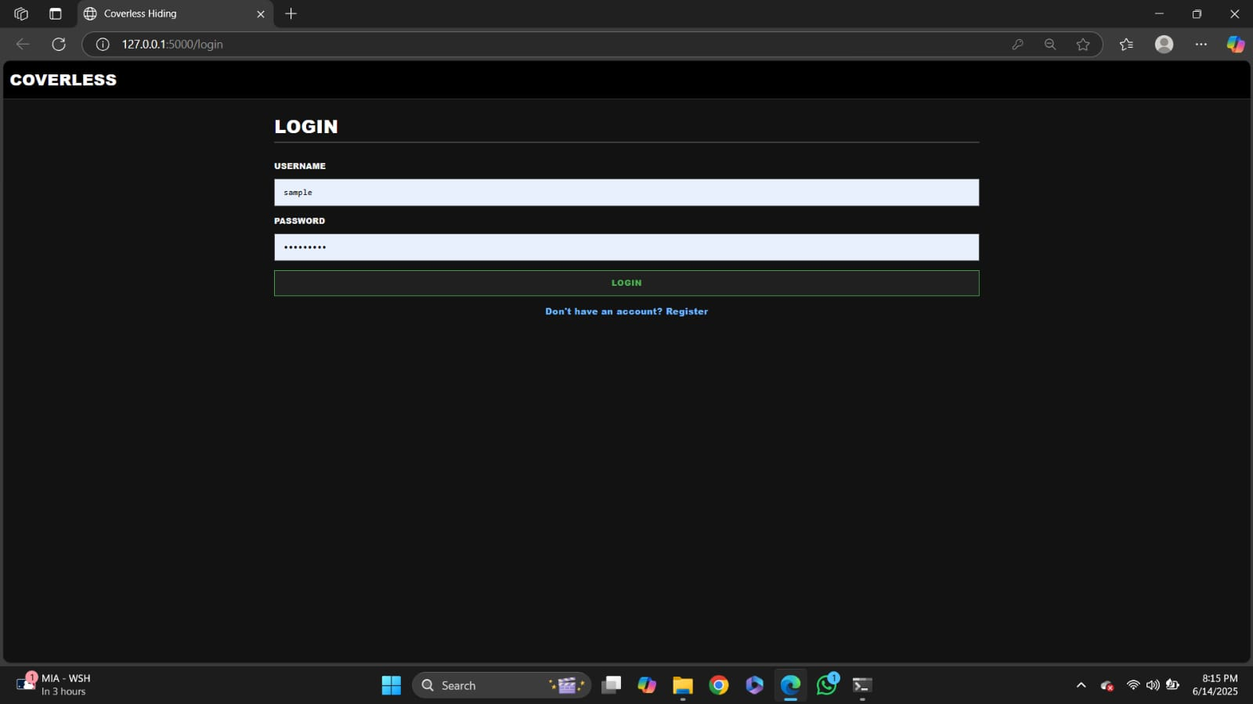
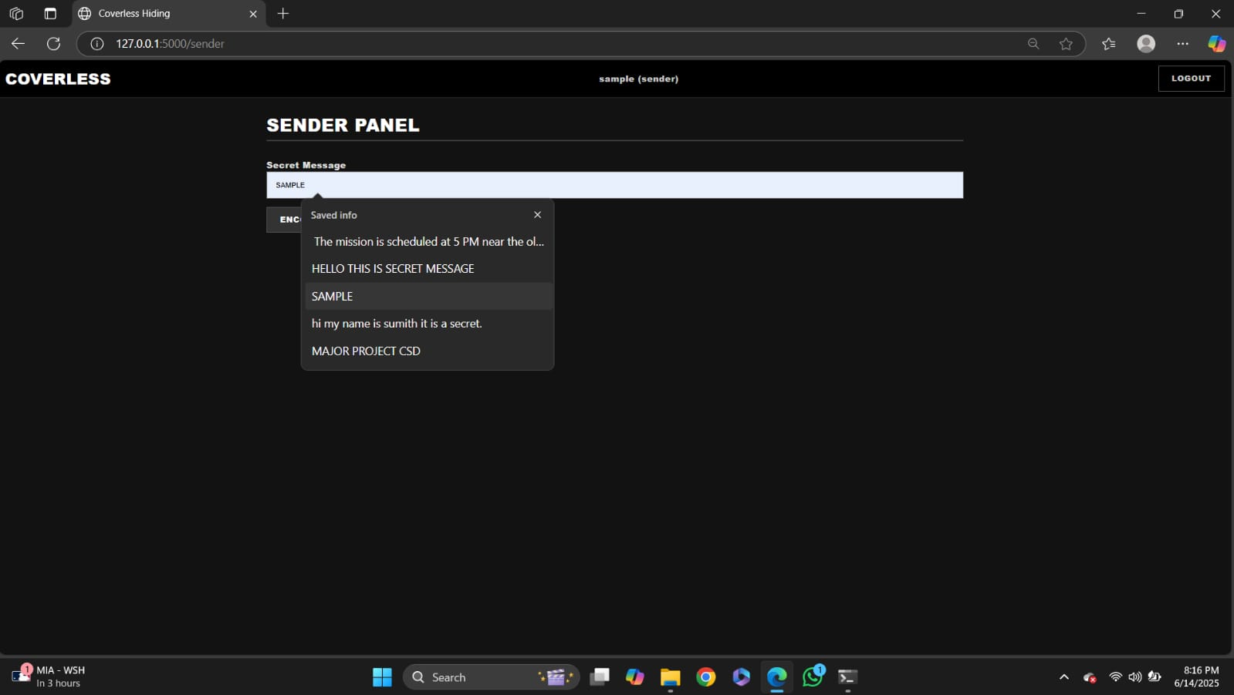
RESULT
Fig 1 : login page
Fig 2 : sender panel

Slide 11
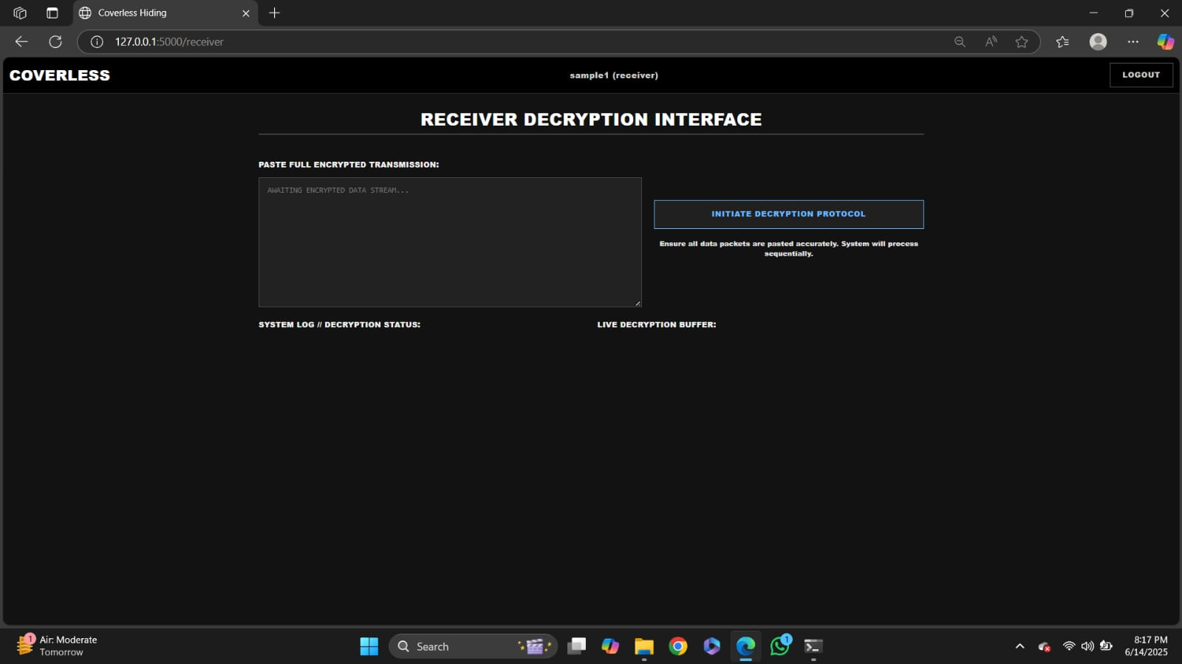
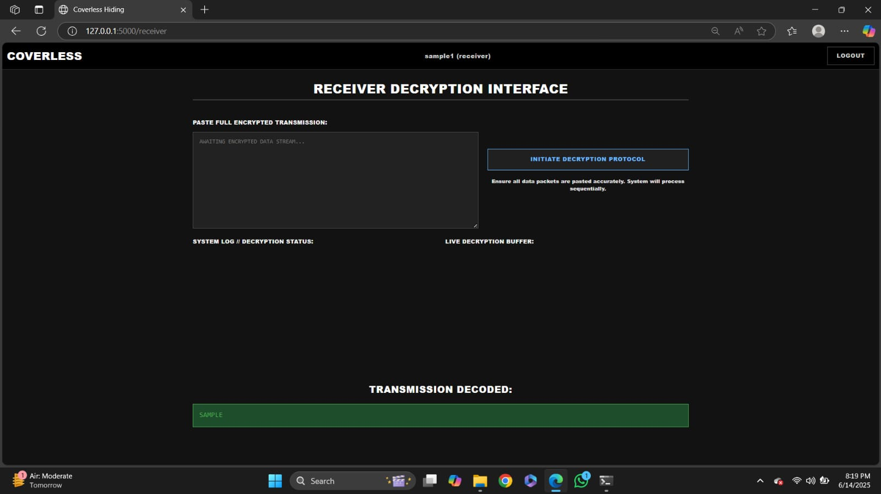
Fig 3 : receiver decryption interface
Fig 4 : transmission decoded

Slide 12
TESTING
Dataset Selection: Choosing a large web text corpus as the reference database.
Encoding Process:
Convert secret data (e.g., binary or text) into index values.
Match these indexes with pre-selected web texts.
Send only the list of text URLs or references (not the actual data).
Decoding Process:
The receiver accesses the same web text database.
Reconstructs the secret message using the shared reference rules.
Testing Aspects:
Accuracy: Ensure correct encoding/decoding of the secret message.
Security: Evaluate how hard it is to detect hidden communication.
Robustness: Test how changes in web text affect the retrieval of data.
Speed: Measure how quickly data can be encoded and decoded.

Slide 13
CONCLUSION
In summary, the coverless information hiding technique based on Web Text represents a significant advancement in the field of secure and covert communication. By leveraging naturally occurring sentences from mapping secret information to these sentences without modifying any underlying data, the system overcomes many limitations of traditional steganographic methods.
The implementation demonstrated how natural language can act as a stealthy carrier of information, providing strong resistance against detection and analysis while maintaining message integrity and readability.
Future enhancements involving AI-driven natural language generation and cryptographic integration will further improve the robustness and adaptability of this technique. Ultimately, this work contributes to developing innovative, practical solutions for privacy and security in an increasingly monitored digital world.

Slide 14


